Slide 1



DRIP IRRIGATION AND LEAKAGE DETECTION SYSTEM FIRST REVIEW
By
SANGEETH KUMAR R [927621BEC173]
SANDHEEP S [927621BEC171]
SANTOSH KUMAR S [927621BEC182]
SARAN S [927621BEC184]
Guided by
Dr. V. MARISELVAM
ASSISTANT PROFESSOR/ECE

Slide 2
INTRODUCTION
Drip irrigation is sometimes called trickle irrigation and involves dripping water onto the soil at very low rates (2–20 liters per hour) from a system of small-diameter plastic pipes fitted
Drip irrigation is a type of micro-irrigation system that has the potential to save water and nutrients by allowing water to drip slowly to the roots of plants, either from above the soil surface or buried below the surface. The goal is to place water directly into the root zone and minimize evaporation.

Slide 3
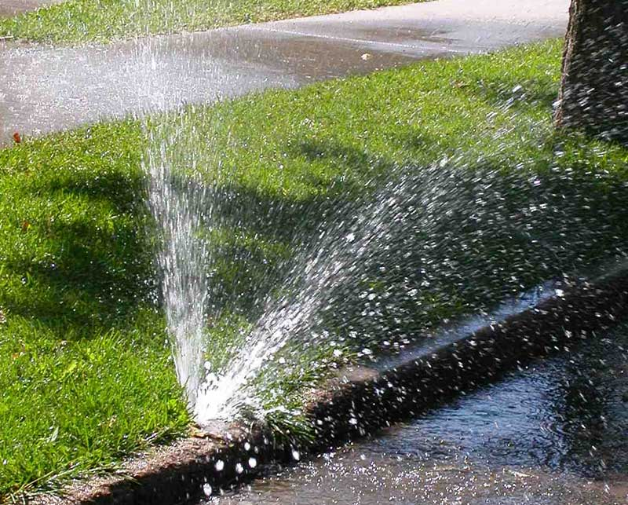
PROBLEM STATEMENT
Drip irrigation causes more water loss, and sometimes pipes will break and cause a leakage of water.
In order to maintain the regular water flow this system can be used.

Slide 4
OBJECTIVES
To control the leakage of water on the pipe, if there is any leakage in the pipe, that will be indicated by using a buzzer, and the motor will turn off. This process gives the message to the desired person.

Slide 5
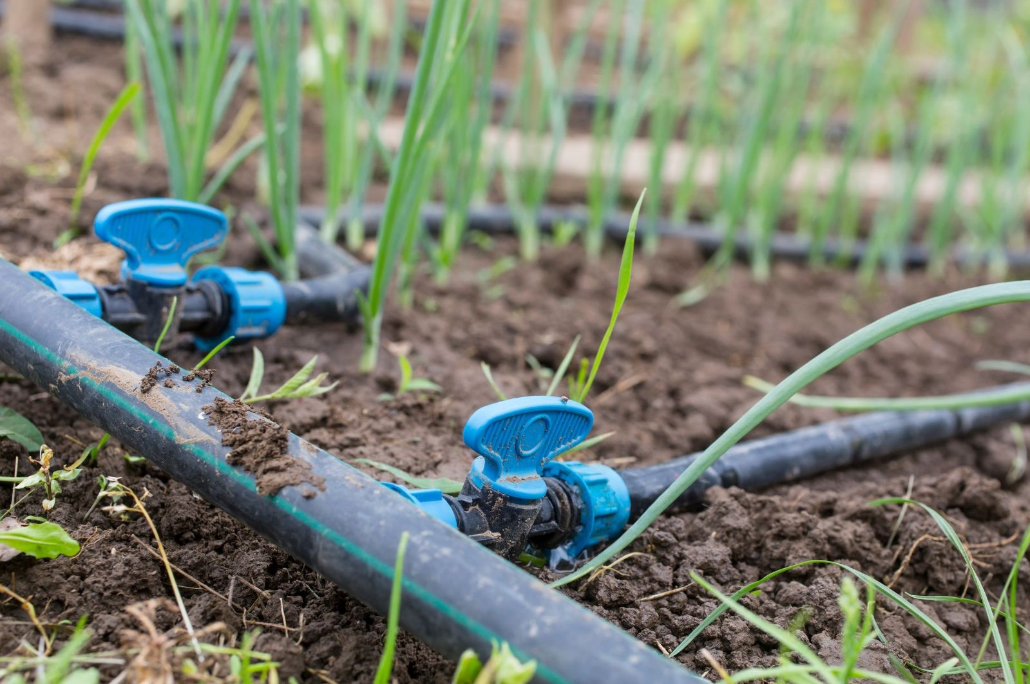
EXISTING SYSTEM
Existing drip irrigation methods rely on a network of pipes, tubing, and emitters to deliver water directly to plant roots. Water is typically released in controlled drips or drops, ensuring efficient and targeted irrigation, primarily in agriculture and landscaping applications.

Slide 6
PROPOSED SYSTEM
The proposed system fixes the L-shaped pipe at the end of the pipe line, and the water sensor is placed at the top of the L-shaped pipe based on the pressure of the water that is pumped by the motor. The water level is raised till the top of the lid where the sensor is placed, the sensor detects the water, and it will be in a normal state, but the water level is decreased then the sensor will not detect the water and it will indicate the message by using a buzzer, and the motor will turn off. A message is to the person.

Slide 7
COMPARED WITH EXISTING
All the equipments required are same as compared to the existing method.
But in our project,we are proposed to handle the water efficiently and in order to reduce the leakage in the drip irrigation system.
This leakage detection system is used in all irrigation methods.
This irrigation system can ensure that there is a proper supply for the plants.

Slide 8
MODULES IDENTIFIED
Arduino UNO
5V Relay
Moisture Sensor
Submersible Motor
Battery

Slide 9
PLAN OF WORK COMPLETION
Completed
Brought components like Arduino UNO, 5V Relay, Moisture Sensor.
To be done
To complete the code for water sensor and moisture sensor and assemble the components.

Slide 10
CONCLUSION
The integration of drip irrigation and leakage detection offers a holistic solution for efficient farming and responsible water management. This system maximizes crop yields, conserves water resources, and minimizes economic losses by addressing both irrigation precision and leak prevention, fostering sustainable agriculture and environmental stewardship.

Slide 11
REFEREANCES
O. V. Biryukova and I. V. Koretskaya, "Selection of Ultrasonic Sensors for Distance Monitoring," 2020 Systems of Signal Synchronization, Generating and Processing in Telecommunications (SYNCHROINFO), Svetlogorsk, Russia, 2020, pp. 1-4, doi: 10.1109/SYNCHROINFO49631.2020.9166089..
B. Mondal, R. Sarkar and N. Mandal, "Design and Implementation of an RF-Based Wireless Displacement Transmitter," in IEEE Sensors Journal, vol. 20, no. 3, pp. 1383-1392, 1 Feb.1, 2020, doi: 10.1109/JSEN.2019.2947318.
Y. Yasa, E. Sahin, C. Acar, A. Gozutok, E. Firat and E. Mese, "Servo motor driver design for high performance applications," 2013 3rd International Conference on Electric Power and Energy Conversion Systems, Istanbul, Turkey, 2013, pp. 1-6, doi: 10.1109/EPECS.2013.6713062.
Y. A. Badamasi, "The working principle of an Arduino," 2014 11th International Conference on Electronics, Computer and Computation (ICECCO), Abuja, Nigeria, 2014, pp. 1-4, doi: 10.1109/ICECCO.2014.6997578.

